Slide 1

SBRR MAHAJANA FIRST GRADE COLLEGE (Autonomous) Jayalakshmipuram, Mysuru 570009 Affiliated to University of Mysore
Re-Accredited by NAAC with ‘A’ grade, College with Potential for Excellence
Project title:
FITNESS AND HEALTH TRACKER APPLICATION
Submitted by :
Keerthan kumar k U01BH22S0111
Nitish kumar s U01BH22S0035
Mohammed saif ramzi U01BH22S0271
Under the Guidance of :
Ms. Megha A P
Assistant Professor
Dept. of BCA
1

Slide 2
Agenda
Abstract
Introduction
Existing system
Proposed system
Technology stack
Conclusion
Future Enhancements
Bibliography
Result

Slide 3
Abstract
Fitness Pro provides a practical, real-world solution to everyday fitness challenges.
The system promotes long-term engagement by tailoring the user experience based on personal goals.
The primary objective of this system is to provide users with a platform where they can register/login, set fitness goals, book professional trainers, and submit reviews.
The technologies and features combined together aim to build a reliable, effective, and interactive environment for fitness enthusiasts..

Slide 4
Introduction
The Fitness Management System is a full-stack web application designed to streamline user fitness tracking and trainer interaction
In today’s health-conscious world, maintaining fitness and tracking personal health goals have become essential parts of daily life.
The Fitness Pro project integrates various technologies and modules such as trainer booking, goal-based progress tracking, and rating systems to enhance user motivation and accountability.
Trainers can manage bookings and respond to user requests, while administrators can monitor system-wide activities.

Slide 5
The core objectives of the system include:
User Authentication.
Trainer Booking System.
Goal Setting and Progress Tracking.
Trainer Reviews and Ratings.
Security and Data Privacy.
Store and manage user profiles and goals.
Simplifies user journey from registration to personalized training

Slide 6
Existing system
In recent years, the rise of digital fitness solutions has significantly transformed the way individuals engage with fitness. Numerous fitness platforms are available, each offering various features aimed at improving physical health, fitness, and wellness. The most popular platforms focus on tracking workouts, offering workout plans, providing dietary recommendations.

Slide 7
Some prominent fitness platforms include :
Strava:
Primarily used by cyclists and runners, Strava tracks activity, monitors performance over time, and allows users to compare their progress with others.
Fitbit:
Known for its wearable fitness trackers, Fitbit also provides an app that tracks physical activity, heart rate, sleep, and other health metrics.
These platforms focus on tracking fitness progress, offering workout programs, and promoting community support.

Slide 8
Proposed system
The proposed system addresses the limitations of existing fitness applications by integrating user-centric features such as progress validation, interactive booking workflows, and goal-based trainer recommendations.
It offer users a personalized fitness management experience by combining profile tracking, trainer booking, and goal monitoring in a single system

Slide 9
Key Features of the Proposed System:
User Registration and Login:
Secure login system that allows only registered users to access booking and profile features.
Trainer Booking system:
Users can view trainers and book only one trainer at a time. And A "Book Now" button changes to "Booked" after successful booking.
Popup notifications:
JavaScript-based popups provide real-time success or error messages for user actions like booking or goal setting.
Goal setting and tracking:
Users can define specific fitness goals and The system recommend trainers based on selected goals.

Slide 10
Technology stack
🖥️Frontend:
HTML, CSS, Tailwind CSS
JavaScript
🗄️ Backend:
PHP for server-side scripting
MySQL for database management
🔐 Authentication:
Session-based login system
Role-based access for users and trainers
🧩 Tools Used:
XAMPP (Apache, MySQL)
VS Code for development
phpMyAdmin for database operations

Slide 11
Hardware requirements :
Requirement | Description
Processor | Intel Core i3 or higher
RAM | Minimum 4 GB RAM
Hard Disk | Minimum 10 GB free space
Display | Standard HD Monitor
Input Devices | Keyboard and Mouse
Operating System | Windows 11

Slide 12
Software requirements :
Software Component | Description / Purpose
Operating System | Windows 10/11.
Web Browser | Google Chrome for testing the UI.
Code Editor / IDE | Visual Studio Code – For writing HTML, CSS, JavaScript, PHP, and SQL code.
Local Server Environment | XAMPP – Includes Apache (for running PHP) and MySQL (for database management).

Slide 13
Conclusion
The fitness management system has been developed as a full-stack web application with a user - Centered approach, combining convenience, progress tracking, and personalized fitness services in a single platform.
Key highlights of the system include:
A functional trainer booking system with goal-based recommendations
Goal setting and user-specific progress monitoring
Trainer request handling with approval flow and booking limitations
Secure backend integration using PHP and MySQL

Slide 14
Future enhancements
There are multiple possibilities for expanding and improving the system in the future, such as:
Mobile application.
AI-based recommendations.
Chat or messaging module.
Gamification elements.
Progress visualization tools.
Integration with wearables.
Multilingual support.

Slide 15
Bibliography
Below is a list of references and tools used during the development of the fitness and health tracker application project.
Tailwind CSS Documentation https://tailwindcss.com/docs
PHP Manual – Official Documentation https://www.php.net/manual/en/
MySQL Documentation – Database Management https://dev.mysql.com/doc/
Visual Studio Code – Official Documentation https://code.visualstudio.com/docs
XAMPP – Apache Friends https://www.apachefriends.org
Chatgpt - Assisted in project planning, code structuring, and documentation writing
https://chat.openai.com/

Slide 16
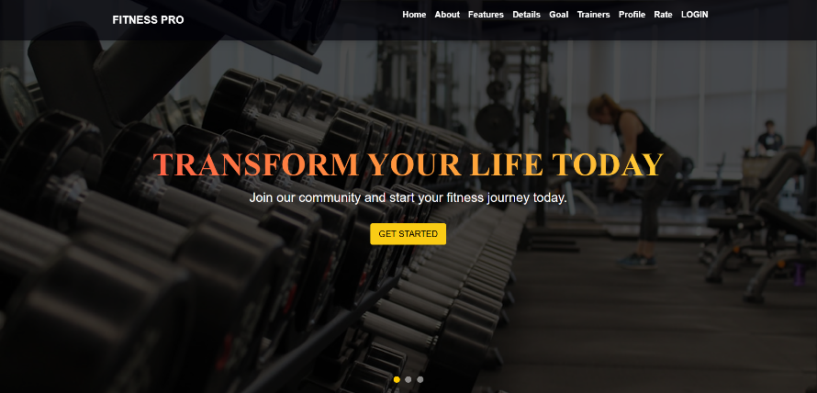
Live project – screenshots
1. Index page

Slide 17
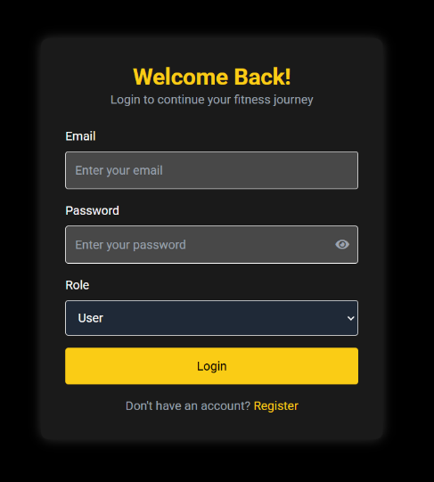
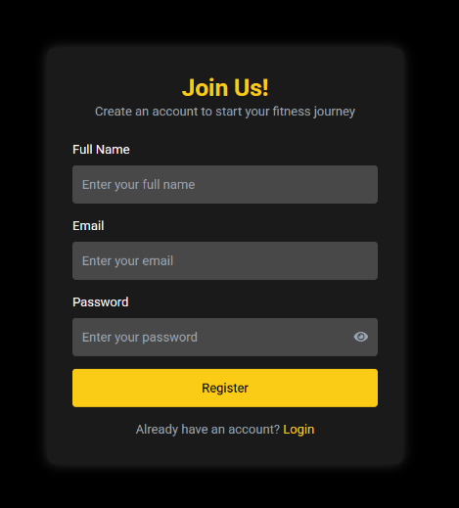
2. Login page
3. Register page

Slide 18
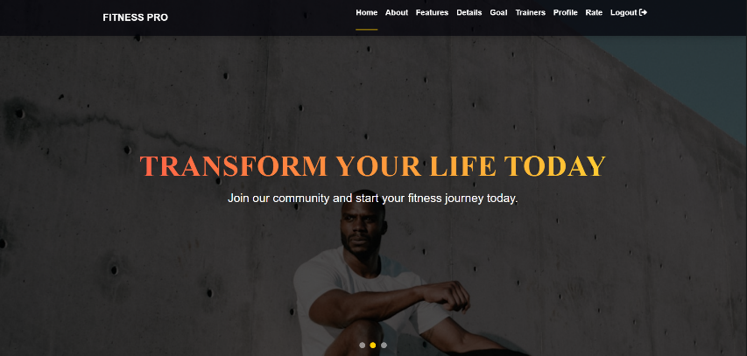
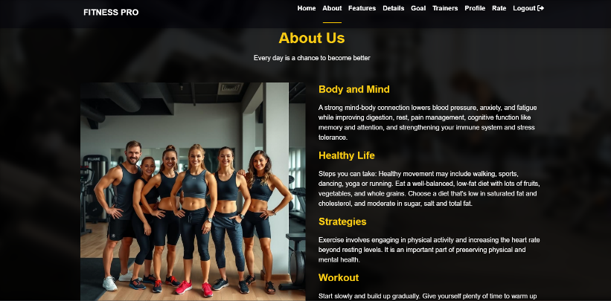
4. Home page
5. About page

Slide 19
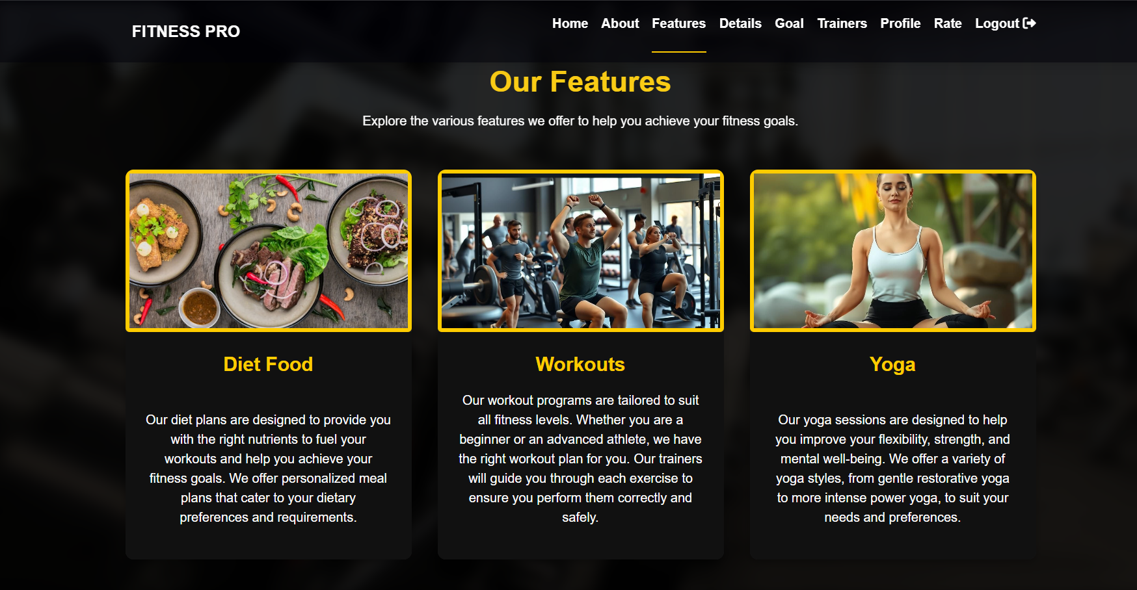
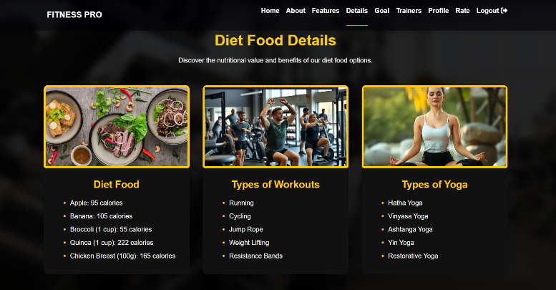
6. Features page
7. Details page

Slide 20
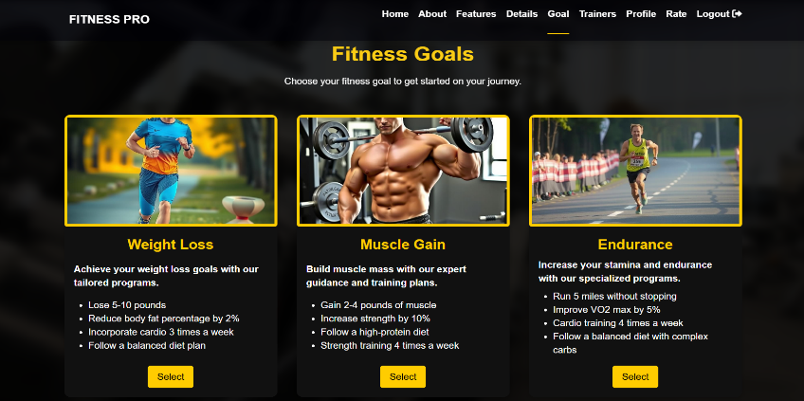
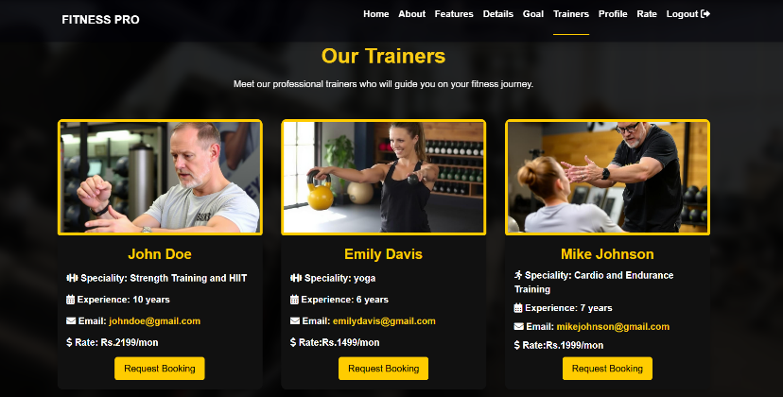
8. Goals page
9. Trainers page

Slide 21
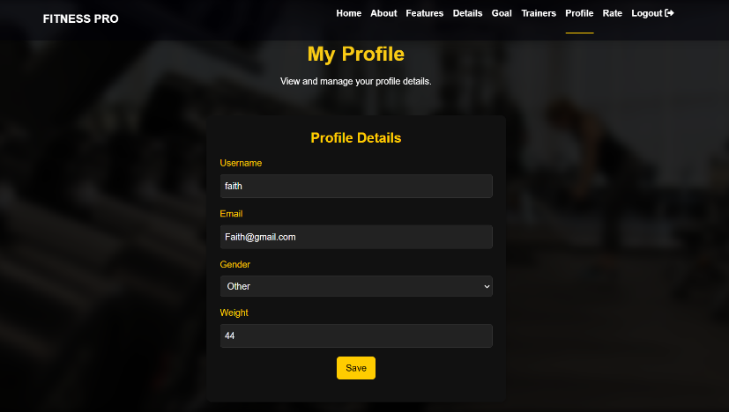
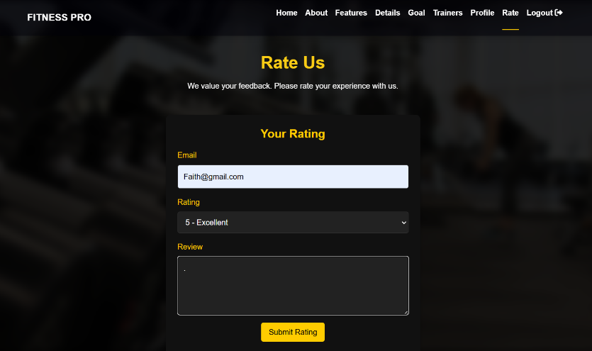
10. Profile page
11. Review page

Slide 22
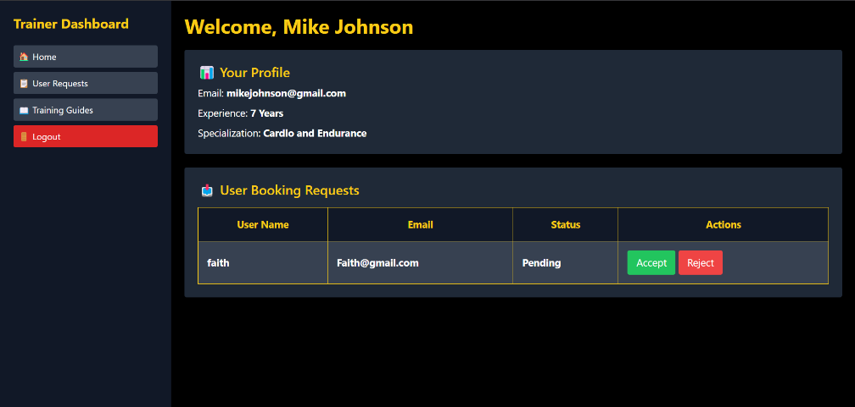
12. Trainers dashboard

Slide 23
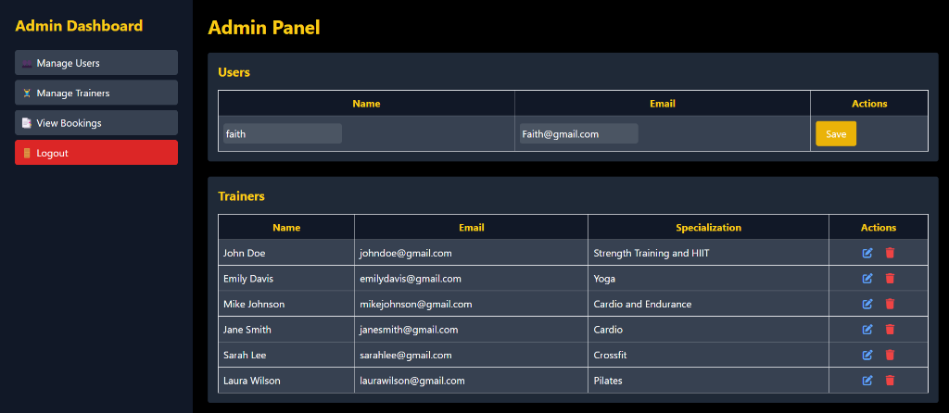
12. Admin dashboard

Slide 24
Thank you

